Slide 1

Tail Recursion in Stack and Queue ADTs
Data Structure | ADT: Stack and Queue
Data Structure | ADT: Stack and Queue | Bachelor of Engineering | Discover. Learn. Empower.
DISCOVER · LEARN · EMPOWER
Notes:
Welcome everyone to today's lecture on Tail Recursion within the context of Stack and Queue ADTs. We will explore how this specific recursion pattern optimizes memory usage. This concept is crucial for understanding efficient algorithm design in our data structures course.

Slide 2
Course Outcomes
SLIDE 2 / 10
Course Outcome
CO | BT LEVEL | DESCRIPTION
CO1 | BT1 | Understand and apply basic data structures, algorithms, complexity analysis, ADTs, arrays and linked lists.
CO2 | BT2 | Apply and implement stacks and queues in problem-solving.
CO3 | BT3 | Analyse and apply searching, sorting, and hashing techniques.
CO4 | BT4 | Construct and apply tree structures and traversal techniques.
CO5 | BT5 | Represent and solve graph problems using DFS, BFS, and graph algorithms.
Chandigarh University
2 / 10
Notes:
Today's session directly addresses our Course Outcomes. CO1 is covered as we analyze the complexity of recursive functions in ADTs. CO5 is relevant because tail recursion is often used in graph traversal algorithms like DFS to prevent stack overflow.

Slide 3
Learning Objectives
SLIDE 3 / 10
Learning Outcomes
1
Define tail recursion as a special case of recursion where the call is the last action.
2
Identify the structural difference between standard recursion and tail recursion in code.
3
Explain how tail recursion optimizes stack memory usage compared to standard recursion.
4
Demonstrate a tail recursive function for traversing a linked list or stack.
Chandigarh University
3 / 10
Notes:
By the end of this lecture, you will be able to define tail recursion clearly. You will learn to spot it in code and understand why it is safer for deep recursion. We will also write a simple example to see the memory difference.

Slide 4
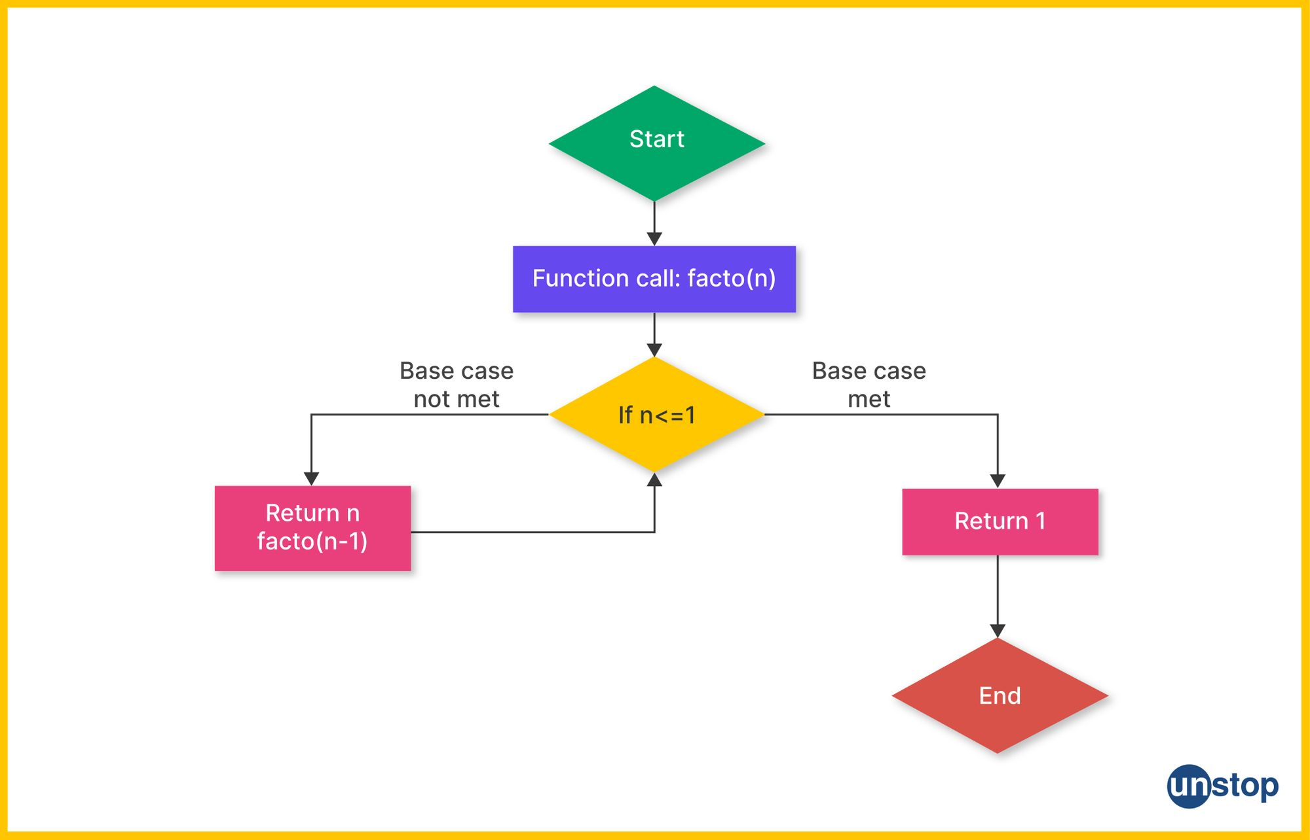
Lecture
SLIDE 4 / 10
Definition of Tail Recursion
1
Tail recursion occurs when the recursive call is the final operation in the function.
2
No further computation is performed after the recursive call returns a value.
3
The function returns the result of the recursive call directly without modification.
4
This structure allows the compiler to optimize the function call mechanism.
Recursion In C | How-To, Working, Types & More (+Examples)
Chandigarh University
4 / 10
Notes:
Think of a function where the very last thing it does is call itself. If there is no addition or multiplication after that call returns, it is tail recursive. For example, if a function returns 'call(n-1)' directly, that is the tail position.

Slide 5
Lecture
SLIDE 5 / 10
Standard vs Tail Recursion
1
Standard recursion performs operations after the recursive call returns a value.
2
Standard recursion requires a new stack frame for every pending operation.
3
Tail recursion requires no pending operations after the call is made.
4
Tail recursion allows the current stack frame to be reused by the compiler.
Chandigarh University
5 / 10
Notes:
In standard recursion, the computer must remember to add the result later, so it keeps the stack frame alive. In tail recursion, there is nothing left to do, so the computer can reuse the current frame. This is like finishing a task and immediately starting the next one without writing notes.

Slide 6
Lecture
SLIDE 6 / 10
Stack Memory Optimization
1
Standard recursion creates O(n) stack frames for a depth of n.
2
Tail recursion can be optimized to use O(1) stack space effectively.
3
The compiler replaces the recursive call with a jump instruction.
4
This optimization prevents stack overflow errors in deep recursive calls.
Chandigarh University
6 / 10
Notes:
The key benefit is memory efficiency. A standard recursive factorial of 1000 might crash the stack, but a tail recursive version runs safely. The compiler transforms the recursion into a loop internally, saving significant memory resources.

Slide 7
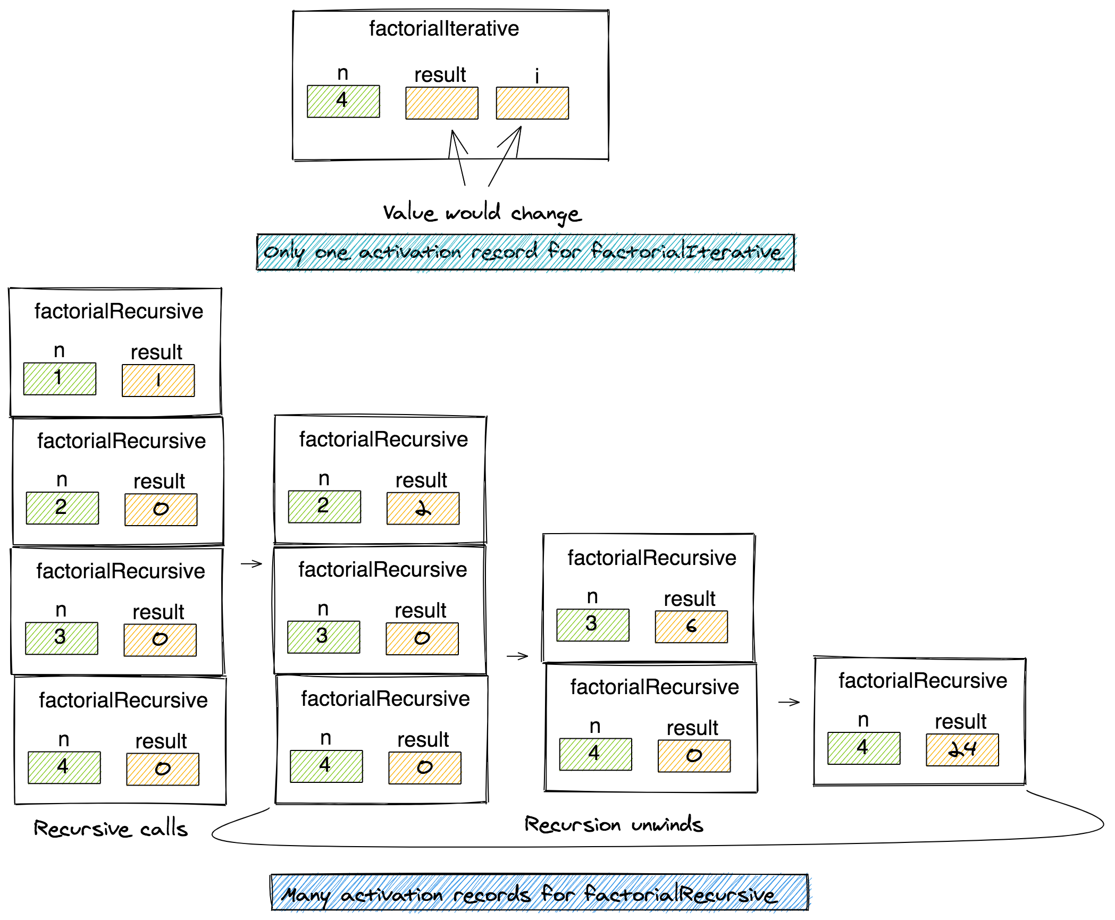
Example
SLIDE 7 / 10
Factorial Function
STANDARD FACTORIAL
return n × factorial(n-1) requires waiting for the call.
TAIL FACTORIAL
return factorial(n-1, n × result) passes the accumulator as a parameter.
• The accumulator holds the intermediate result, eliminating the need for post-call math.
• This pattern is essential for implementing efficient stack operations recursively.
Source: storage.googleapis.com
Chandigarh University
7 / 10
Notes:
Let's look at the factorial function. The standard version multiplies n by the result of the call, so it must wait. The tail version passes the running product as an argument. This way, the calculation is complete before the call returns.

Slide 8
Example
SLIDE 8 / 10
Linked List Traversal
1
Traversing a linked list can be done recursively using tail recursion.
2
The function passes the current node and an accumulator for the result.
3
Base case is when the node is null, returning the accumulated value.
4
This approach is safer for very long lists compared to standard recursion.
Chandigarh University
8 / 10
Notes:
Imagine traversing a list to count nodes. A tail recursive function passes the count down. When it hits the end, it returns the total. This is much safer for a list with thousands of nodes than a standard recursive approach.

Slide 9
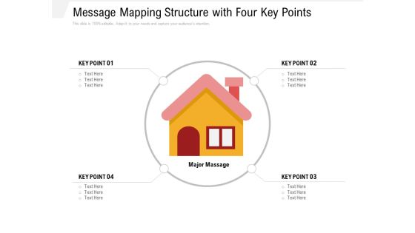
Lecture
SLIDE 9 / 10
Key Takeaways
1
Tail recursion is a recursive call that is the last action in a function.
2
It allows compiler optimization to reuse stack frames and save memory.
3
It converts O(n) stack space usage into O(1) space usage effectively.
4
It is critical for implementing deep recursion in ADTs like stacks and queues.
Source: www.slidegeeks.com
Chandigarh University
9 / 10
Notes:
To summarize, tail recursion is about the position of the call. It is the last thing a function does. This allows the compiler to optimize it into a loop. Remember this for your exams and practical implementations.

Slide 10
Lecture
SLIDE 10 / 10
References
DATA STRUCTURES
A Pseudocode Approach with C — Gilberg, Forouzan
• Data Structures — Lipschutz
• Data Structure Using C — AK Sharma
• C and Data structure — P. S. Deshpandey
Chandigarh University
10 / 10
Notes:
Please refer to these standard textbooks for further reading on data structures and recursion. They provide detailed pseudocode and C implementations that complement today's lecture. These resources will help you master the concepts of ADTs and algorithmic complexity.

